Slide 1
Lecture 3: RAM Model and Algorithm Analysis
Keren Zhu
kerenzhu@cse.cuhk.edu.hk

Slide 2
Topics for this lecture
The RAM Computation Model
A model of computation that we assume to use in typical algorithm language
A general and abstract model of modern CMOS computer
Worst-Case Analysis
How to analyze an algorithm and find its runtime efficiency
With an example of insertion sorting

Slide 3
RAM model

Slide 4
RAM model in a nutshell
RAM model
Stand for Random Access Machine
Random access means the memory can be read and changed in any order
Defines a simple yet accurate abstraction of a computing machine
It contains a memory and a single CPU
Let’s only care about basic concept of it in this class

Slide 5
RAM model memory
Memory
An infinite sequence of cells, each of which contains the same number w of bits
A word is a sequence of w bits, where w is called the word length.
Each cell has an address: the first cell of memory has address 1, and the second cell has address 2, and so on
So, we assume infinite memory, there will be no memory shortage
In real-world, the memory address can be more complicated
Depends on the computer architecture
Won’t be covered in this class

Slide 6
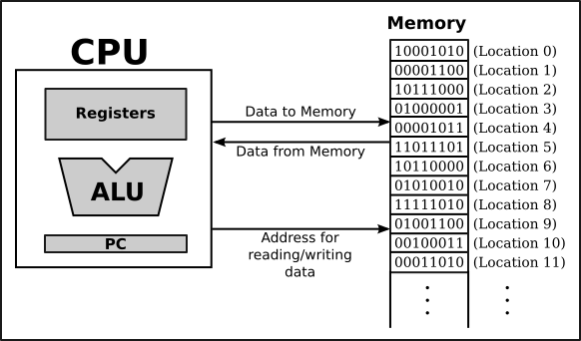
RAM model CPU
CPU contains
Registers
Contains a fixed number r of registers, each stores w bits
r depends on architecture
Dara need to be read and
load into registers

Slide 7
RAM model CPU
CPU can execute a sequence of atomic operations
Atomic means it is not uncuttable
An atomic operation effectively happens all at once
Each simple operation takes 1 time step
The cost of an execution of a sequence of atomic operations is the length the sequence, namely, the number of atomic operations
The cost is in time

Slide 8
Atomic operations
The CPU can do a set of atomic operations
1. Register (Re-)Initialization
Set a register to a fixed value (e.g., 0, −1, 100, etc.), or to the content of another register.

Slide 9
Atomic operations
The CPU can do a set of atomic operations
2. Arithmetic
Take the integers a, b stored in two registers, calculate the results and store the result in a register
Like a+b, a-b, a*b, a/b
In real world, the cost of different arithmetic can be different
Depends on computer architecture (number of CPU cycles)
Depends on chip implementation (clock frequency and power)

Slide 10
Atomic operations
The CPU can do a set of atomic operations
3. Comparison and Branching
Take the integers a, b stored in two registers, calculate the results and store the result in a register
a < b, a = b, a > b

Slide 11
Atomic operations
The CPU can do a set of atomic operations
4. Memory Access
Take a memory address A currently stored in a register. Do
one of the following:
Read the content of the memory cell with address A into a designated register (overwriting the bits there).
Write the content of a designated register into the memory
cell with address A (overwriting the bits there).
In real world, memory access is overall much slower than the other operations
Memory access operations can run in different speed: L1-L3 cache, DRAM, etc.

Slide 12
Atomic operations
The CPU can do a set of atomic operations
5. Randomness
RANDOM(x, y): Given integers x and y (satisfying x ≤ y), this operation returns an integer chosen uniformly at random in [x, y], and places the random integer in a register.
In this class, we will mainly focus on deterministic algorithms

Slide 13
In summary, RAM
In RAM model,
Each atomic operation takes 1 time step.
Loops and subroutines are not atomic operations.
Each memory access takes one time step, and there is no shortage of memory.
RAM gives us a simple and abstract model to analyze an algorithm
Independent on the underlying computer
Simple way to count the cost: defined by the number of atomic functions

Slide 14
Worst-case analysis

Slide 15
Worst-case running time
The worst-case cost (or worst-case time) of an algorithm under a problem size n is the largest running time of the algorithm on all the (possibly an infinite number of) size-n input
Give an upper bound on the running time
Formally, size of n is the number of bits required to write out that input
Extended reading: why knapsack problem is pseudo-polynomial
We won’t need to concern about this definition in this class
There is also average-case running time
Usually is the same as the worst case
Analysis needs probabilistic analysis

Slide 16
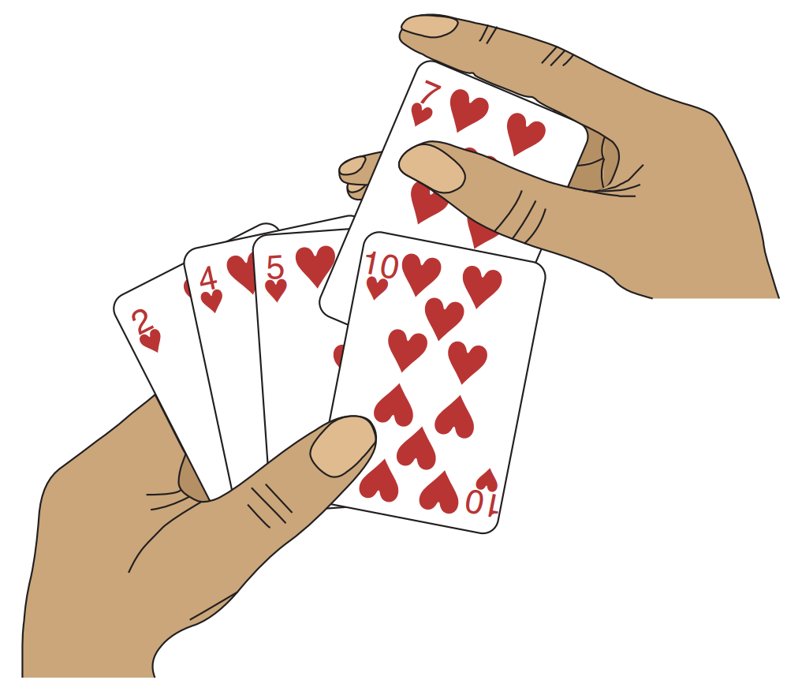
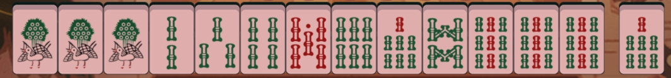

Insertion Sort
Sorting problem:
Input: A sequence of n numbers $<a_{1},a_{2},…,a_{n}>$
Output: A permutation (reordering) $<a_{1}^{′},a_{2}^{′},…,a_{n}^{′}>$of the input sequence such $a_{1}^{′}≤a_{2}^{′}≤…a_{n}^{′}$
Can you think of a using scenario (and potential an algorithm)?
This is actually an illustration of insertion sort

Slide 17
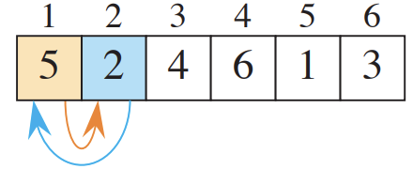
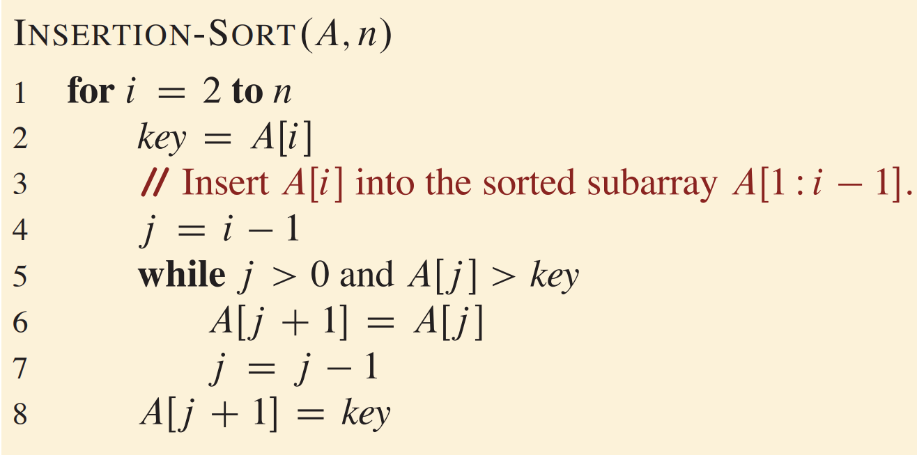
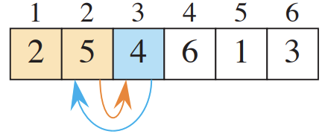
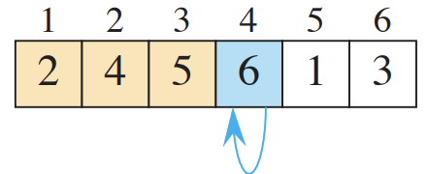
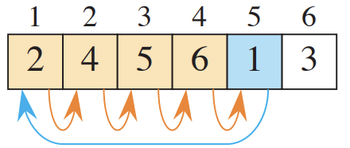
Pseudocode for insertion sort
What is the running time for this algorithm?

Slide 18







Count the cost of insertion sort
Line | Cost
1
2
3
4
5
6
7
8
$$c_{1}$$
$$c_{2}$$
0
$$c_{4}$$
$$c_{5}$$
$$c_{6}$$
$$c_{7}$$
$$c_{8}$$

Slide 19





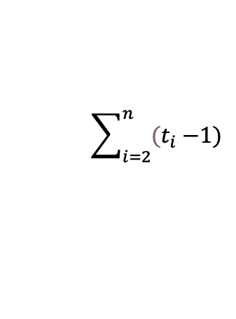


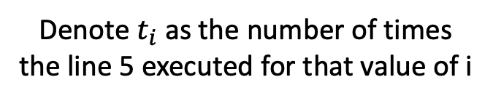
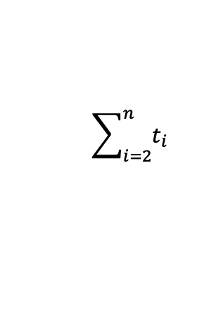




Count the cost of insertion sort
Line | Cost | Times
1
2
3
4
5
6
7
8
$$c_{1}$$
$$n$$
$$c_{2}$$
$$n−1$$
0
$$n−1$$
$$c_{4}$$
$$n−1$$
$$\sum_{i=2}^{n}{t_{i}}$$
$$c_{5}$$
$$\sum_{i=2}^{n}{{(t}_{i} −1)}$$
$$c_{6}$$
$$c_{7}$$
$$\sum_{i=2}^{n}{{(t}_{i} −1)}$$
Denote $t_{i}$ as the number of times the line 5 executed for that value of i
$$c_{8}$$
$$n−1$$

Slide 20
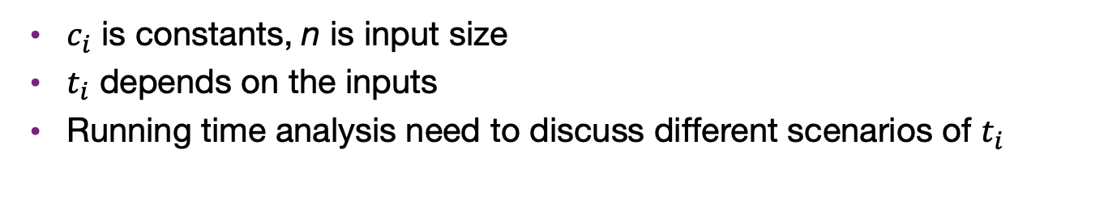
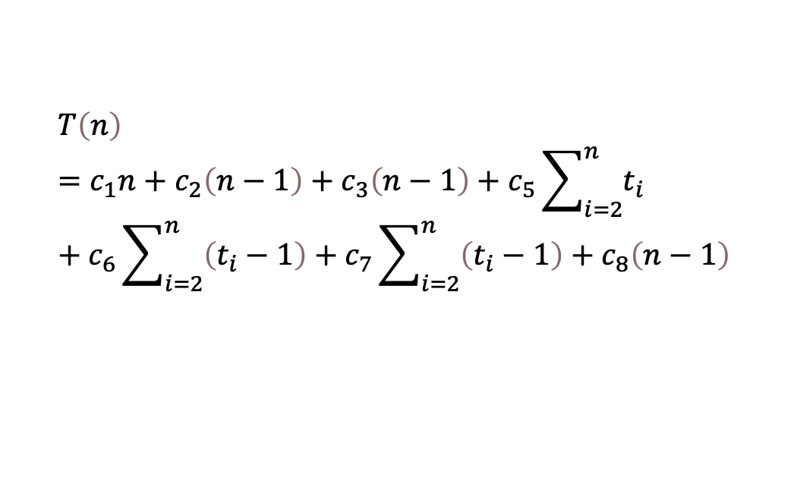
Analysis the runtime cost for insertion sort
Sum the runtime cost
$$T\left(n\right)=c_{1}n+c_{2}\left(n−1\right)+c_{3}\left(n−1\right)+c_{5}\sum_{i=2}^{n}{t_{i}}+c_{6}\sum_{i=2}^{n}{\left(t_{i}−1\right)}+c_{7}\sum_{i=2}^{n}{\left(t_{i}−1\right)}+c_{8}\left(n−1\right)$$
$c_{i}$ is constants, n is input size
$t_{i}$ depends on the inputs
Running time analysis need to discuss different scenarios of $t_{i}$

Slide 21
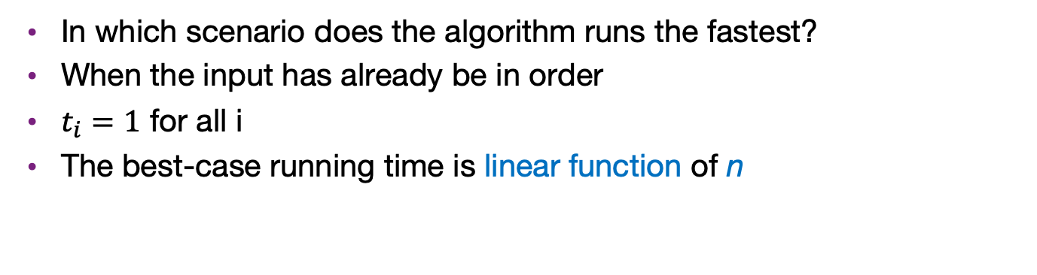
Best-case for insertion sort
In which scenario does the algorithm runs the fastest?
When the input has already be in order
$t_{i}=1$ for all i
The best-case running time is linear function of n
$$T\left(n\right)=c_{1}n+c_{2}\left(n−1\right)+c_{3}\left(n−1\right)+c_{5}(n−1{)+c}_{8}\left(n−1\right)$$
1 | 2 | 3 | 4 | 5 | 6
1 | 2 | 3 | 4 | 5 | 6

Slide 22
Worst-case for insertion sort
In which scenario does the algorithm runs the slowest?
When the input is in a reserve sorted order
The while loop need to go to the front of array every time
6 | 5 | 4 | 3 | 2 | 1
1 | 2 | 3 | 4 | 5 | 6

Slide 23

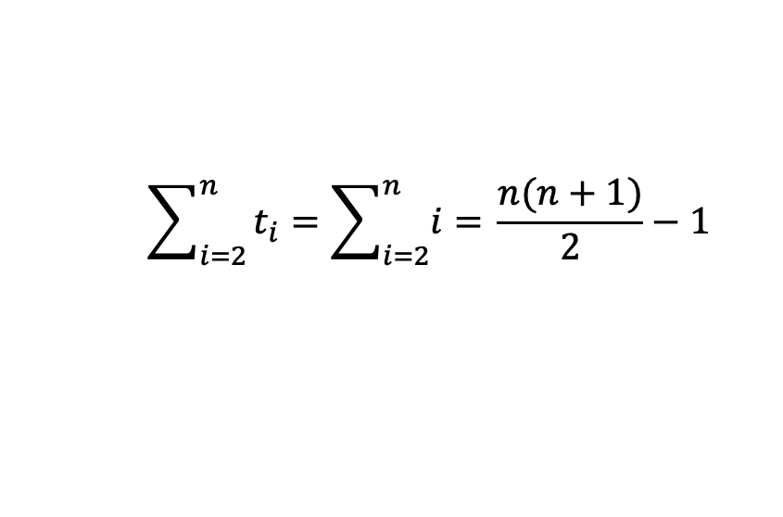
Worst-case time analysis
Key is to find $t_{i}$
Line 5 would compare every element before i
Therefore, $t_{i}=i$, where $i=2, 3, …, n$
$$\sum_{i=2}^{n}{t_{i}=\sum_{i=2}^{n}{i= }}\frac{n(n+1)}{2}−1$$

Slide 24
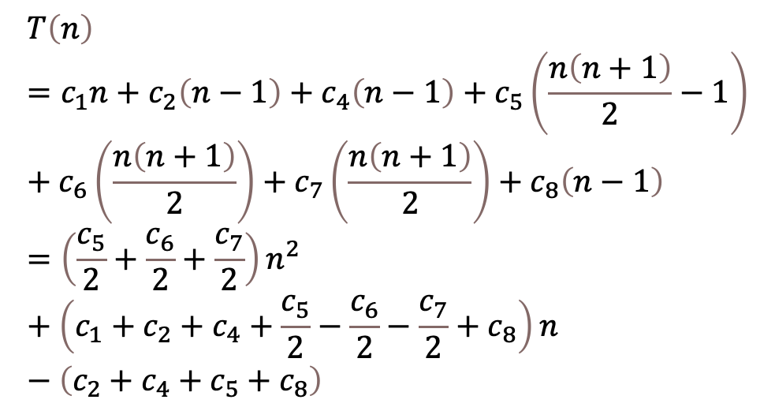
Putting them together
The T(n) is a quadratic function of n
What if the linear term coefficient much larger than the quadratic?
Still quadratic growth -> asymptotic analysis
$$T\left(n\right)=c_{1}n+c_{2}\left(n−1\right)+c_{4}\left(n−1\right)+c_{5}\left(\frac{n\left(n+1\right)}{2}−1\right)+c_{6}\left(\frac{n\left(n+1\right)}{2}\right)+c_{7}\left(\frac{n\left(n+1\right)}{2}\right)+c_{8}\left(n−1\right)=\left(\frac{c_{5}}{2}+\frac{c_{6}}{2}+\frac{c_{7}}{2}\right)n^{2}+\left(c_{1}+c_{2}+c_{4}+\frac{c_{5}}{2}−\frac{c_{6}}{2}−\frac{c_{7}}{2}+c_{8}\right)n−\left(c_{2}+c_{4}+c_{5}+c_{8}\right)$$
Quadratic
linear
Constant

Slide 25
Search a number in a sorted array
Input: In the memory, a set S of n integers have been sorted in ascending order in an array Array. Another integer q, the target, is given.
Output: -1 if q is not in S. A nonnegative integer i where Array[i] = q.
Problem input size is n+1
A straightforward way is linear search
Worst-case time complexity linear to n
A more efficient algorithm is binary search

Slide 26
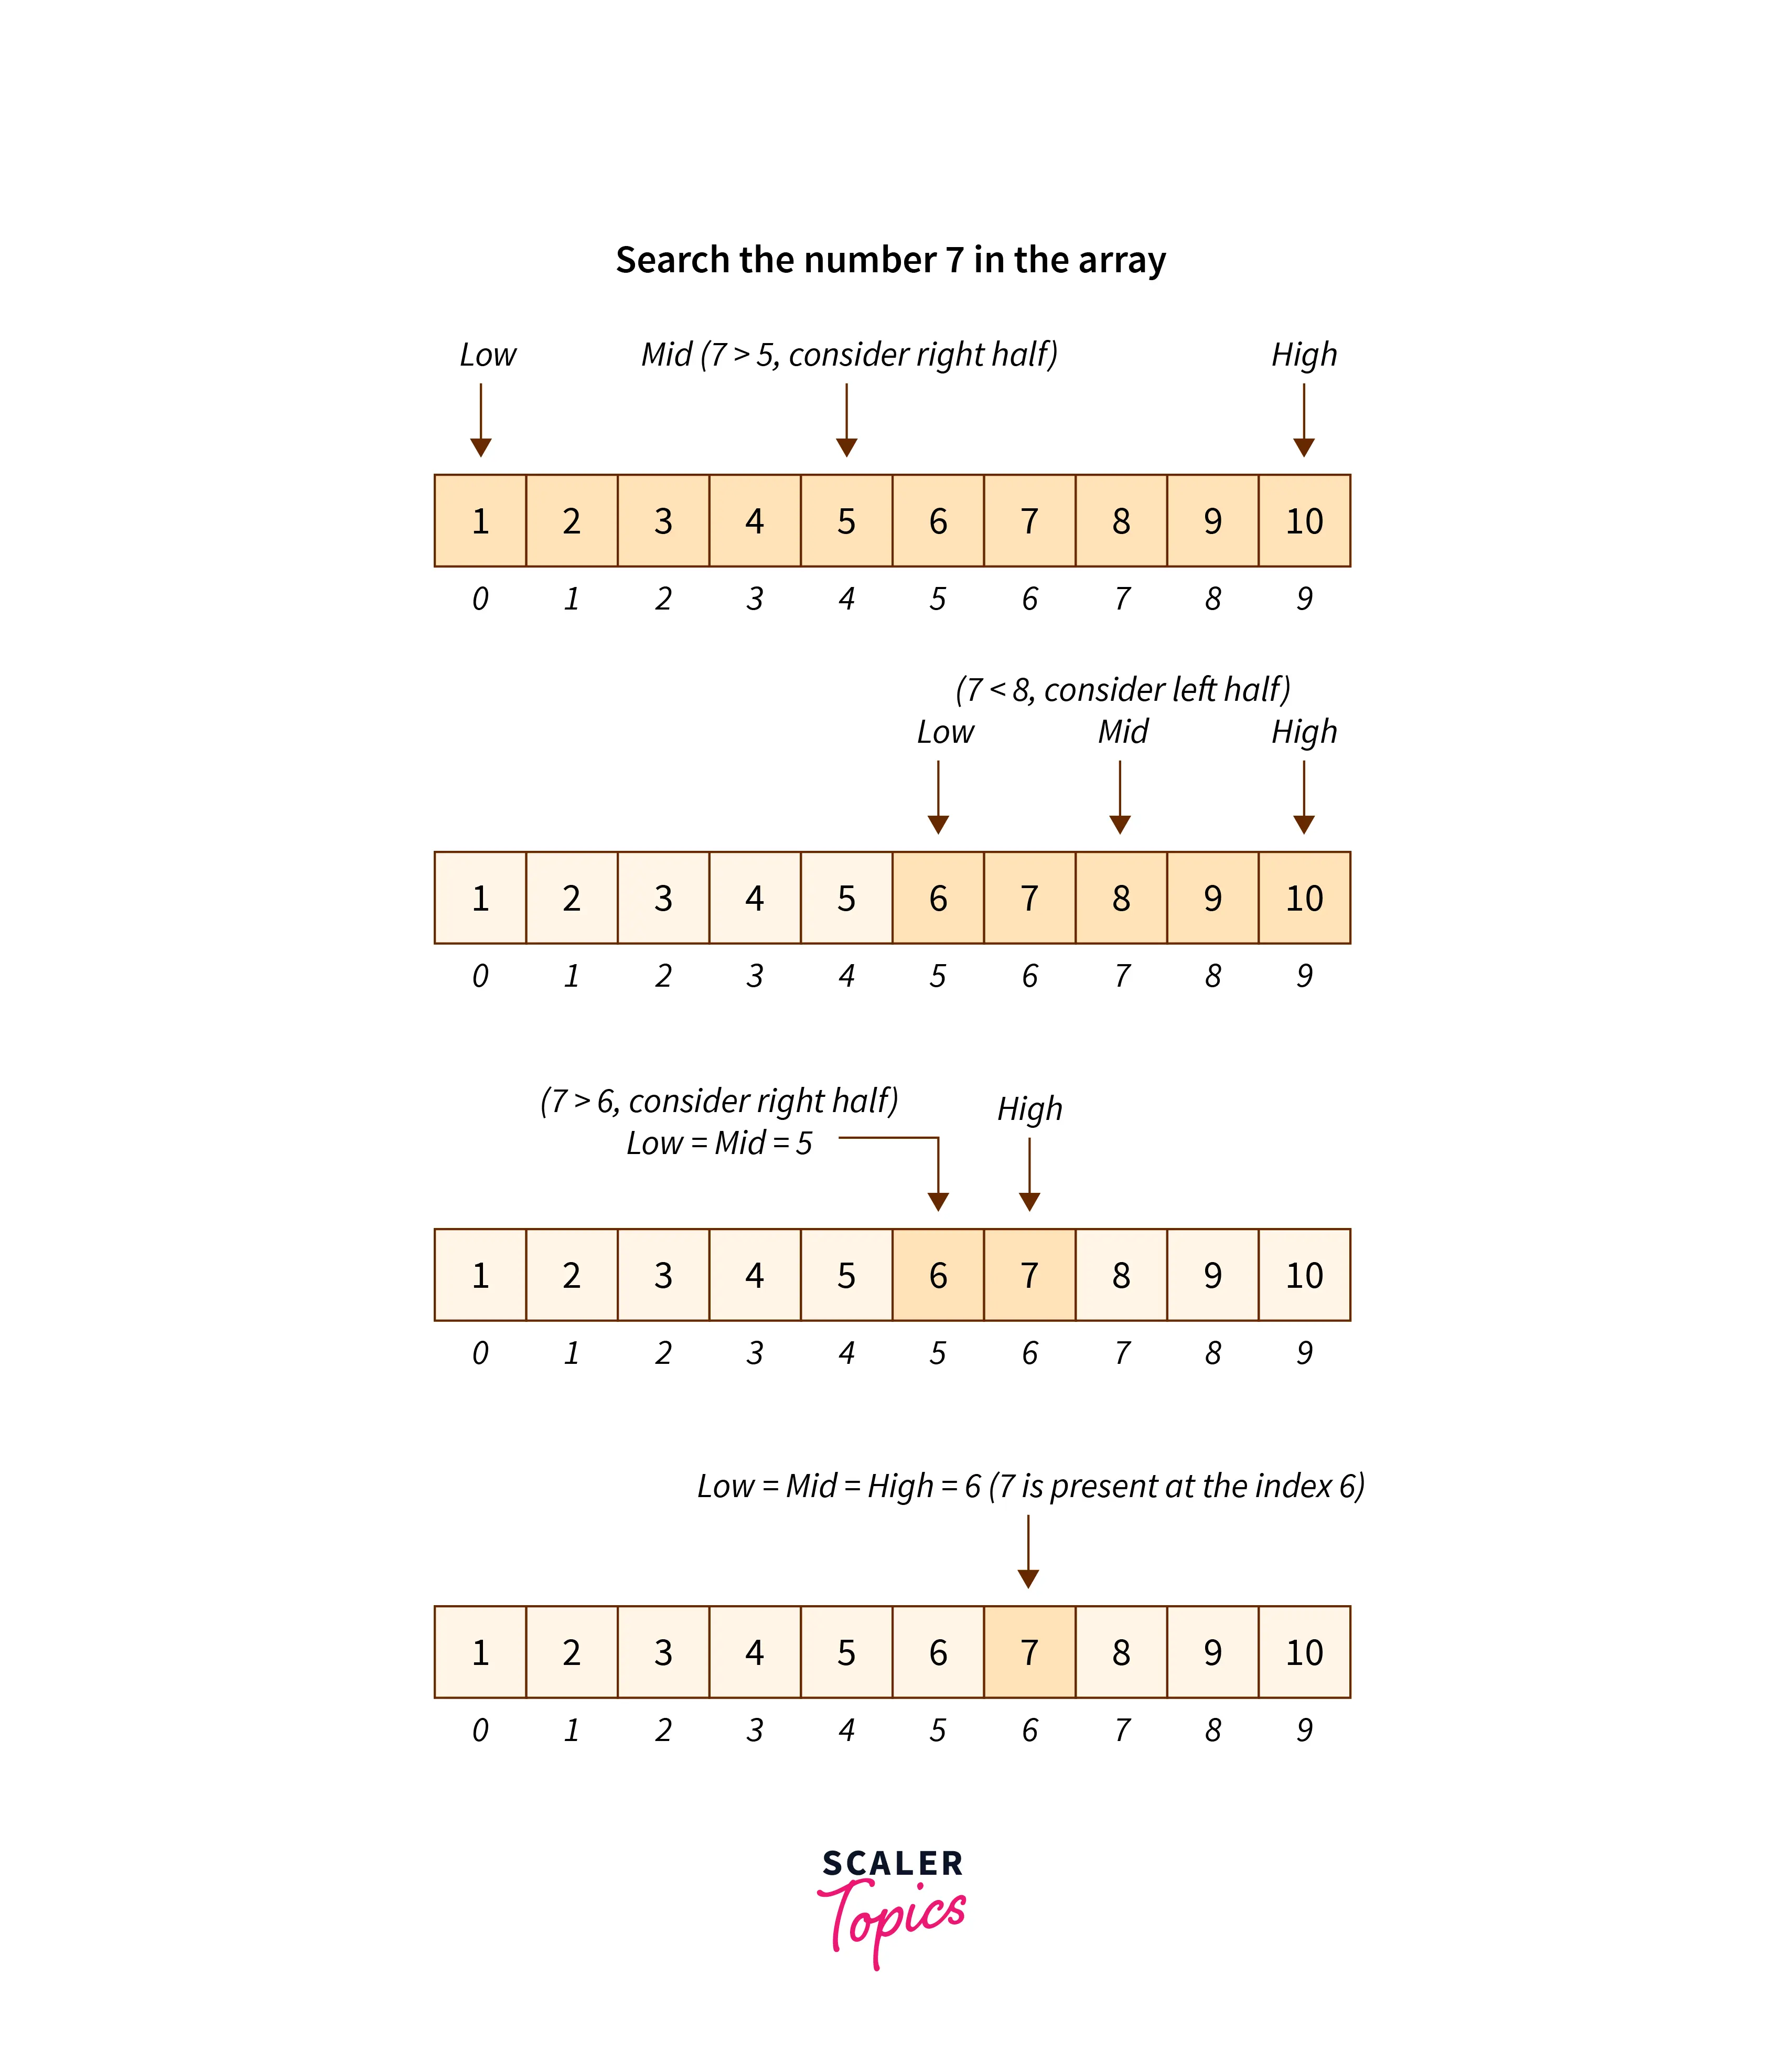
Illustration of binary search
Try to find 7 in 1,2,…,10

Slide 27
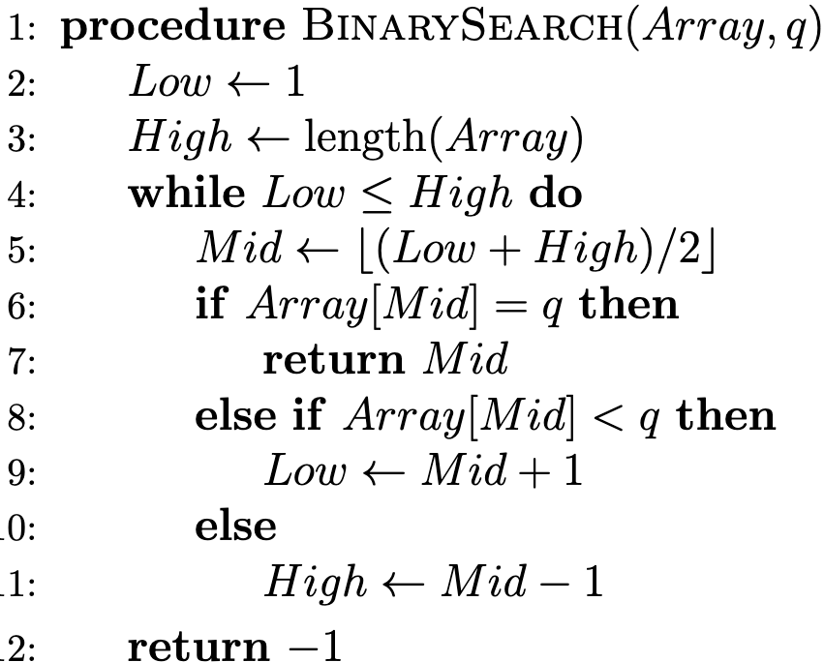
Pseudocode for binary search
How many times?

Slide 28
Analysis by different cases
Let us compare q to different elements in the Mid location
Case 1: q = Array[Mid]
We have found q
Case 2: q < Array[Mid]
We can immediately forget about the second half of array remaining
Case 3: q > Array[Mid]
We can forget about the first half
In summary, we have at most n/2 elements left.

Slide 29
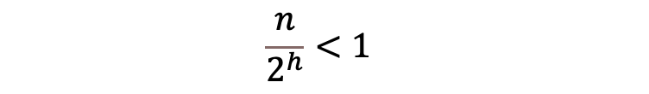
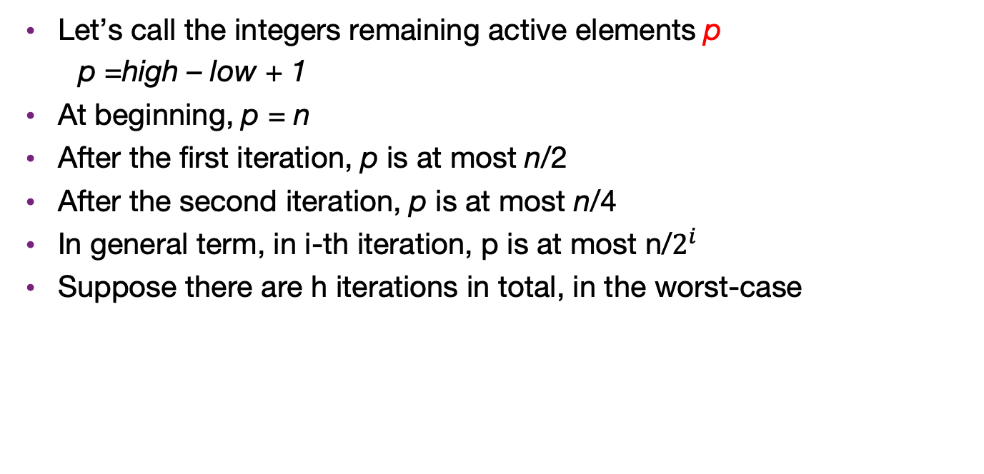

Count the iteration
Let’s call the integers remaining active elements p
p =high – low + 1
At beginning, p = n
After the first iteration, p is at most n/2
After the second iteration, p is at most n/4
In general term, in i-th iteration, p is at most n/$2^{i}$
Suppose there are h iterations in total, in the worst-case
$$\frac{n}{2^{h}}<1$$
$$h = \left\lceil log\left(n\right)+1 \right\rceil$$

Slide 30

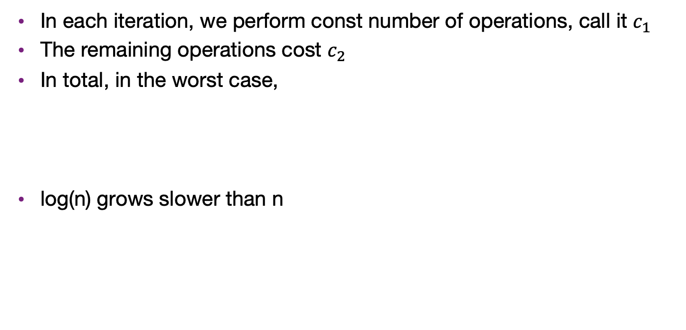
Worst-case time of binary search
In each iteration, we perform const number of operations, call it $c_{1}$
The remaining operations cost $c_{2}$
In total, in the worst case,
log(n) grows slower than n
$$T\left(n\right)=c_{1}\left(1+log\left(n\right)\right)+c_{2}$$

Slide 31
Summary
In most case, we would like to design an algorithm with guarantee in efficiency
The most commonly technique of analysis is worst-case time complexity
(Won’t be in the exam) Sometimes average time complexity is closer to the real world
Quick sort
Simplex algorithm for linear programming

